Slide 1
Customer Profitability & Loyalty Analysis

Slide 2
To quantify the value of our customer base and identify strategic areas to boost revenue and loyalty.
1. Core KPIs: LTV, AOV(Average Order Value), Repeat Rate.
2. Value Drivers: AOV Breakdown by Category.
3. Loyalty Drivers: Repeat Rate by Category.
4. Strategic Focus: Top Customer Segmentation & Recommendations.

Slide 3
LTV is the average total revenue a customer generates over the entire period. It is the true monetary value of acquiring one customer.
LTV = total revenue / total unique customers
AOV is the average money spent per single order. It measures the size of the basket, not the loyalty of the buyer.
AOV = total revenue/total transactions

Slide 4
Key Findings
LTV: ₹4,778
AOV: ₹637
Repeat Rate: 78.89%
Our 78% Repeat Rate is excellent, meaning our business is heavily anchored by returning customers.
Our average AOV (₹637) is low compared to the LTV. This suggests an opportunity to increase the value of each transaction to maximize customer lifetime spend.

Slide 5
AOV by Category
High-AOV Anchors: Categories like Vaccination (₹4,607) and VET DRY FOOD (₹4,330) are 6-7x higher than the store average. They drive major transactional value.
We must ensure customers buying these high-AOV items are always offered related, lower-AOV products (e.g., offer a discount on a new Accessory (low AOV) to every customer buying VET DRY FOOD).

Slide 6
Repeat Rate by Category
Categories like Medicine (57.44% repeat) and DOG SNACKS & TREATS (55.15% repeat) are generating our most regular customers.
Because high-repeat customers rely on these items, maintaining 100% stock availability for these categories is non-negotiable. Out-of-stock here directly impacts long-term loyalty.

Slide 7
Conclusions
We have a highly loyal customer base with strong potential for increased transactional value.
Recommended Actions
Implement cross-selling prompts (online/in-store) to bundle low-AOV items with high-AOV purchases.
Prioritize stock levels and sourcing for high-repeat categories (Medicine, Treats) to avoid switching behavior.
Standardize Category names (e.g., merge "DOG DRY FOOD" and "DogDry Food") before future analysis.

Slide 8
FINAL DASHBOARD

Slide 9
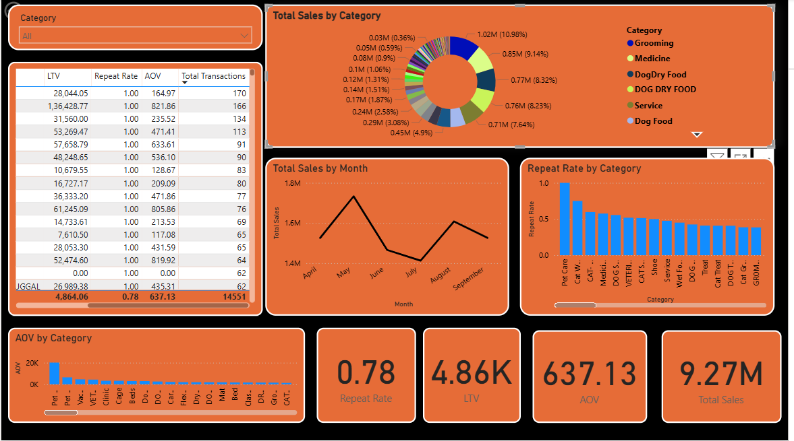

Slide 10
THANK YOU
Pragya

